Slide 1

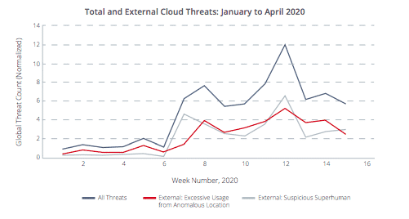
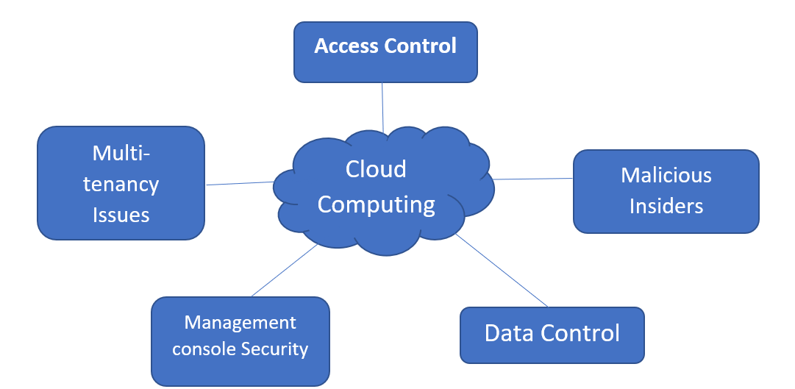
Quantifying Cloud Misbehavior & Malicious Traffic Originating from Cloud Machines
Project Group ID:- 22
<Shivyanshi Shukla, Kartik Sharma, Harshwardhan Niture, Chinmay Chougule, Dr. Ganeshan R., VIT Bhopal>
ABSTRACT
INTRODUCTION
RESULTS
DISCUSSION
The exponential development in cloud security trends has given rise to security challenges such as detecting malicious usage of cloud computers, cloud misbehavior, cloud instance misuse, and so on. Clouds have grown in popularity throughout time as a result of their ability to supply on-demand services at no added expense. It also offers superuser access, allowing customers to tailor cloud computers to their own requirements. This superuser is not always useful, since criminals have discovered ways to circumvent and abuse the privilege. Furthermore, criminals may simply hire cloud workstations and use them to produce unwanted traffic such as spamming, phishing, DoS attacks, and vulnerability assessments, among other things.
We want to effectively evaluate and describe numerous forms of harmful traffic in this survey article, as well as minimize and quantify cloud machine misbehavior and identify the cloud services that create this traffic. In this work, we look at diverse techniques, tool implementation, datasets, and analytical accuracy.
During the projected period, the worldwide cloud computing market is estimated to increase at a Compound Annual Growth Rate (CAGR) of 16.3 percent, from USD 445.3 billion in 2021 to USD 947.3 billion in 2026.Customers can employ cloud services such as content hosting and machine rentals, which are frequently abused by scam artists. These services, in turn, enable them to download, install, and operate their software, as well as upload data. Despite the fact that these services are purchased, the lack of funds does not stop the exploitation of superuser access to machines. Compromised accounts, free trials, or the takeover of legal accounts provide fertile ground for criminals to exploit them with Account Takeover Attacks, while other clouds store dangerous information.
According to comprehensive data undertaken by researchers throughout the world, cloud providers generate nearly 50% of vulnerability scans, which are typically precursors to attacks, despite occupying just 5.4 percent of routable Internet address space. Clouds also account for up to 96 percent of listings on blocklists, which are lists of IP addresses that have previously been linked to misbehavior. This was determined after examining 13 datasets that included a comparative and comprehensive analysis of cloud and non-cloud traffic.
The results from the SVM Kernel five functions are:
Linear kernel function showed accuracy rate of 98.14% and 97.38% attack detection rate whereas false positive and negative rates are 2.61% and 2.98% respectively. Similarly, in case of multilayer perception kernel accuracy rate was 93.05% and it showed attack detection rate of 92.25%. False positive rate in case of multilayer perception kernel was 7.69% and false negative rate was 8.02%. There are five different SVM kernel functions which showed different accuracy rate, attack detection rate, false positive rate and false positive rate. Among the five SVM kernel functions Linear kernel showed the most accuracy rate of 98.14% while it also showed attack detection rate of 97.38% which is highest among all the five.
The security service level agreement (SLA) is allocated to the information's placement, data protecting, differentiation, and information recovery. A variety of security administration standards are available from the Information Technology Infrastructure Library. A Denial-of-Service attack based on HTTP or XML is the most critical issue with cloud computing. These types of violations are simple for the hacker to commit; nevertheless, they are twice as difficult to detect.
Choosing a trustworthy and secure provider is essential. Everything that impacts the storage capacity of your provider also affects your data access. On-site servers contain data in cloud-based storage systems, and servers retain data from numerous users. If your data is shared on the same server, unusual data uploads might pose a security risk.
Attackers can acquire access to sensitive/private information through hijacking. Subscription accounts or cloud service accounts are the accounts that are most vulnerable in cloud settings. Because insiders don't have to hack past firewalls, VPNs, or other security barriers, they can access networks, data, and systems on a trusted level. A bad insider might sell or utilize this knowledge for personal benefit or the target user's collective loss.
MODULES AND METHODS
CONCLUSIONS
1. SVM (Support Vector Machine): It is a tool that analyses the classifier's training set and predicts the final classes of cloud services. Main phases of the SVM based detection framework:
a. Monitoring: Monitor the behavior of the services and collect representative evidences.
b. Classification: Constructs the training set of SVM classifier based on evidences.
c. Punishment: Finds malicious clouds and blacklist them community.
2. Accessing cloud framework: For guarding against unwanted access, corporates should map data flow across devices, apps and systems which will allow thorough examination of cloud utilization.
3. Data Classification: In terms of importance and sensitivity, not all cloud data is created equal. Keeping classification methods to segregate data can help keep data more secure by alerting users to store something locally rather than in the cloud or on a drive.
4. Tools for automating application deployment and management: Even the most experienced security expert may not be able to keep up with the ever-increasing threat from cyber-thieves. Ordinary jobs may be automated, and it can also augment human labour advantages with those of machines - a fundamental feature of sophisticated IT operations.
Clouds may be abused, either by negligence or by purposefully allowing it. We investigated how clouds misbehave and the mitigating measures employed by experts to quantify cloud misbehavior and harmful traffic emanating from cloud devices in our research.
Internet assaults can be considerably decreased if efforts are concentrated on safeguarding these clouds.
REFERENCES
[1] “Cloud Computing Market by Service Model (Infrastructure as a Service (IaaS), Platform as a Service (PaaS), and Software as a Service (SaaS)), Deployment Model (Public and Private), Organization Size, Vertical, and Region - Global Forecast to 2026.” https://www.marketsandmarkets.com/Market-Reports/cloud-computing-market-234.html
[2] Tandon, Rajat & Mirkovic, Jelena & Charnsethikul, Pithayuth. (2020). “Quantifying Cloud Misbehavior.” 10.1109/CloudNet51028.2020.9335812
Five main classes of Security Identification threats

